Slide 1
PEP UP Collaborative Tools
Rupinder Dhaliwal, RD
Manager, Research & Networking
Queen’s University, Kingston General Hospital, Kingston, Ontario

Slide 2
Tools to Operationalize the PEP uP Protocol
www.criticalcarenutrition.com password given when committed to PEP UP Collaborative and INS 2014
Bedside Tools
EN initiation orders
Gastric feeding flow chart
Volume-based feeding schedule
RN Guideline for Diarrhea
EN Guidelines for Surgical Procedures
Bedside Nutrition Monitoring Tool
PEP UP Pocket Guide
Information Sheets
Overview of educational tools
Info sheet for RNs
NIBBLES (MDs, Trophic feeds)
Feeding your Family Member in the ICU
NUTRIC Score
Implementation Tools
Educational Video from PEP UP site
Powerpoint presentations (long and short)
Self-learning module
Posters
Frequently Asked Questions (FAQ)
PEP UP Pointers
Grand Rounds Presentation
Plus a discussion group!

Slide 3
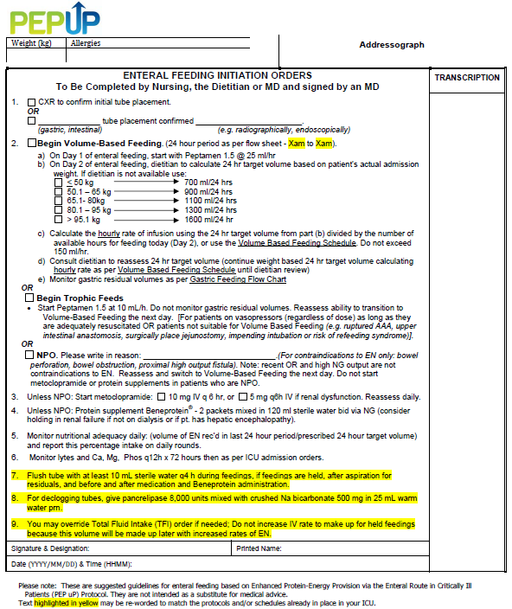

Slide 4
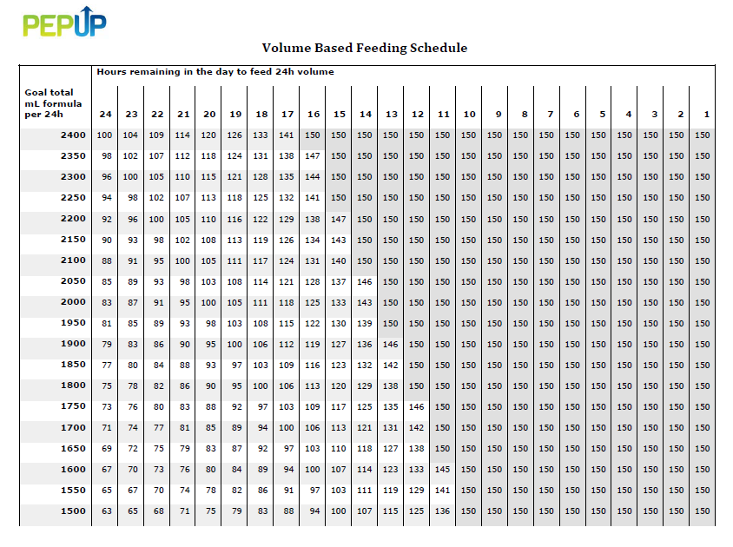
Volume Based Feeding Schedule

Slide 5
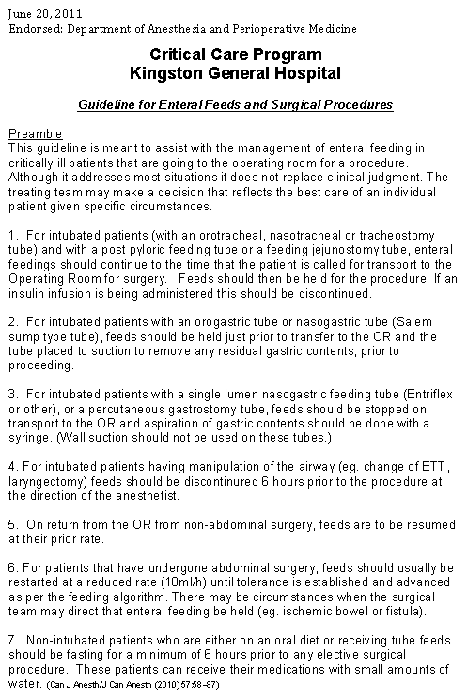
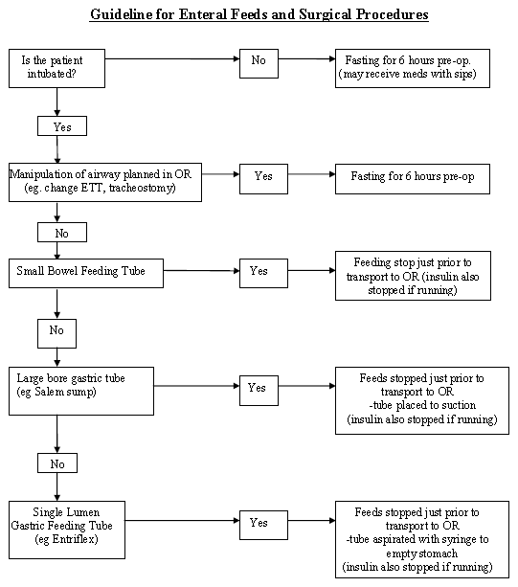
Protocol to Manage Interruptions to EN Due to Non-GI Reasons
Can be downloaded from www.criticalcarenutrition.com

Slide 6



Education and Awareness Tools
PEP uP Pocket Guide
PEP uP Poster

Slide 7
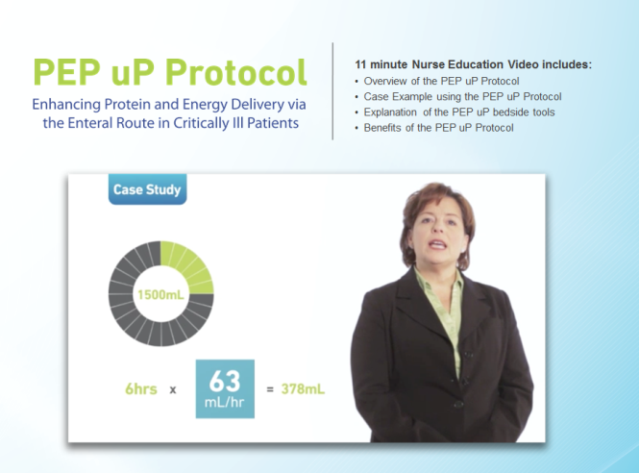
Nursing Education Video

Slide 8
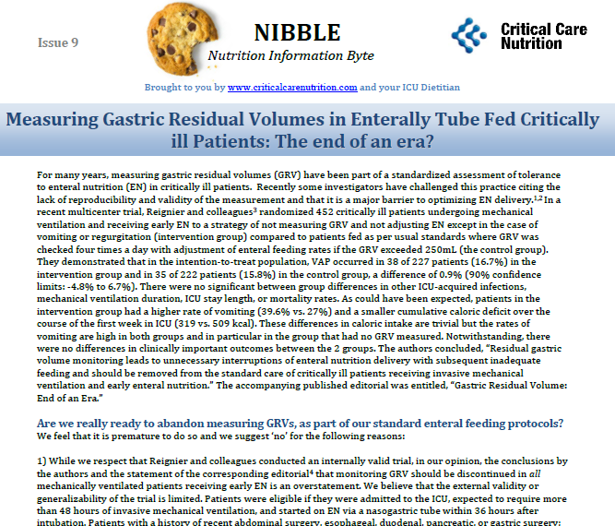

Slide 9
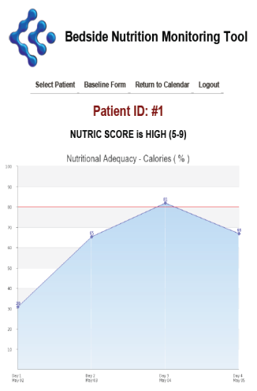
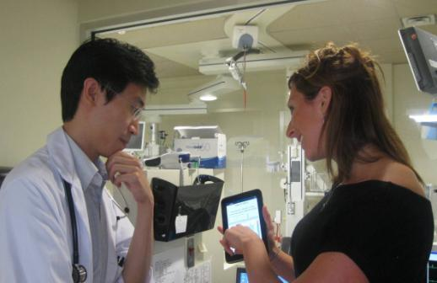
PEP uP Bedside Monitoring Tool

Slide 10


Next Steps
US PEP uP Collaborative
Started April 2014
9 sites as either Tier 1 or Tier 2
Using higher protein semi elemental formula
Supported by Nestle Health Science US
Additional tools being revised
Latin American PEP uP Collaborative
Starting soon!
Aimed at Spanish speaking ICUs
Translation and Implementation: to be led by
Willy Manzanares, MD, Uruguay

Slide 11
International Nutrition Survey 2014

Slide 12
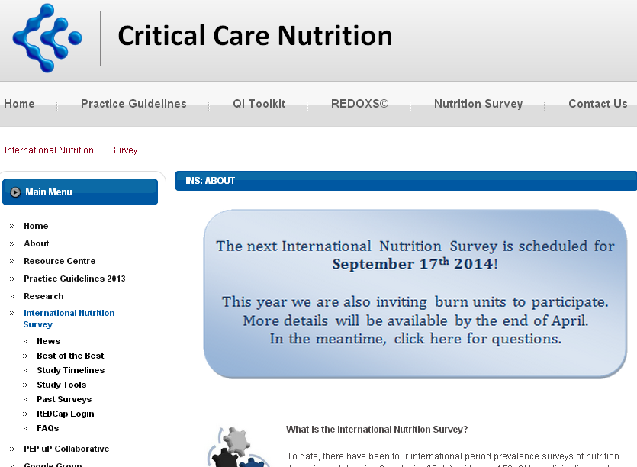

Slide 13
International Nutrition Survey (INS) 2014
Purpose
illuminate gaps between current practice & guidelines
identify practice areas to target for change
History
started in Canada in 2001
6th International audit (2007, 2008, 2009, 2011, 2013 and now 2014)
Methods
Observational, point prevalence study

Slide 14

Methods
Each ICU will identify and enroll 20 consecutive patients
Adults at least 18 yrs age (reduced to 16 yrs for burn units)
vented within first 48 hrs
are in the ICU LOS> 72 hrs
RD to abstract data from chart
Hospital and ICU characteristics
Patient information
Baseline Nutrition Assessment
Daily Nutrition data for 12 days
60 day Patient outcomes
(e.g. mortality, length of stay)
Benchmarking Report provided
Eligible for Best of the Best Award if at least 20 patients

Slide 15
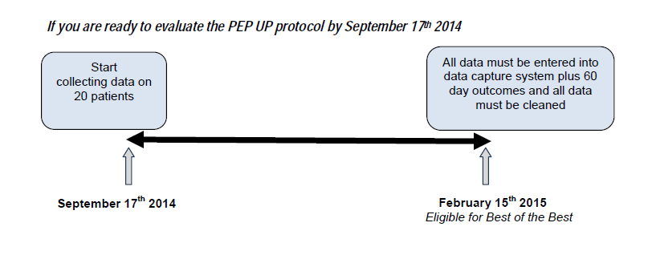
To evaluate the effect of the PEP UP Protocol on current practices, you must participate in the International Nutrition Audit, several months after the protocol has been successfully implemented in your ICU.

Slide 16
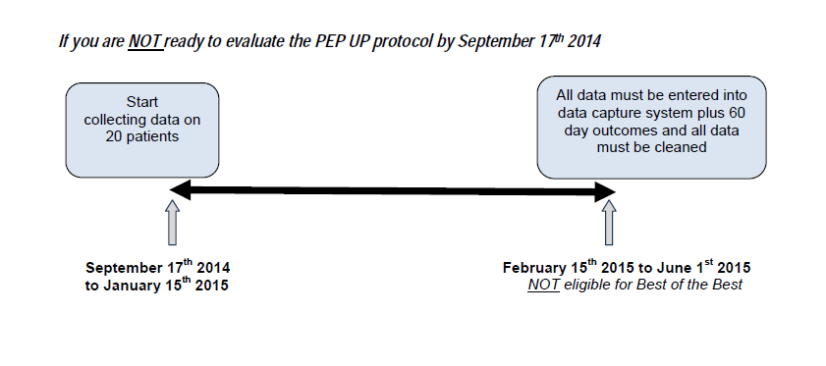

Slide 17
If you have already implemented the PEP UP Protocol and if you want to start collecting data early, you may:
Identify your cohort of 20 patients soon (even now)
Start collecting data on paper Case Report Forms*
Enter the data on our electronic data capture system Sept 17th (or after you obtain Ethics approval, if needed)
* Draft Case Reports sent May 13th 2014, final version in June 2014

Slide 18

What approvals may be needed?
Approval from your Ethics Board (Institutional Review Board)
You will need to check on your end
Ethics Submission Guide available from us for the INS data collection
Data Transfer Agreement
Only if your research office or ethics needs this
2014 Tier 1 sites must have a contract with Nestle US

Slide 19
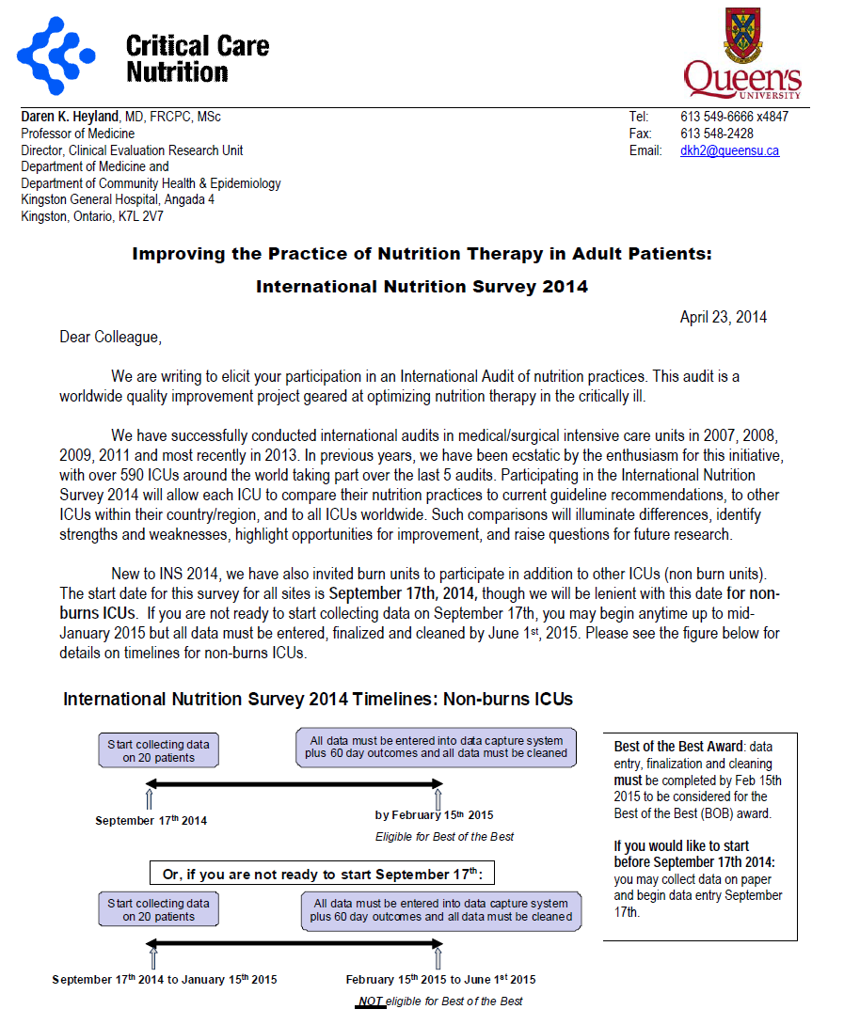

Slide 20
Thank you for your attention Questions? www.criticalcarenutrition.com

